Slide 1
Detection and Identification of Lung/Colon Cancer
Seanmark Paz, Jabali Shah, Yaakov Sternberg
University of San Diego
AAI-521: Applied Computer Vision for AI
Siamak Aram, PhD.
December 6, 2024

Slide 2
Agenda
Introduction and Objective
Dataset information
Model Training
Model Visualization
Member Contributions
Improvements
Notes:
Over the next few minutes, we’ll discuss the significance of this project, the dataset and methods we used, the results we achieved, and the broader impact of our work. Let’s begin with an overview of the problem and our objectives.

Slide 3
Introduction and Objective
Introduction:
Cancer detection through histopathological image analysis is vital, especially for lung and colon malignancies.
Manual diagnostic practices face challenges: time-intensiveness and inter-observer variability.
Computational approaches offer potential but need advancements in tissue classification.
Objective:
Develop a machine learning model to classify histopathological images into five critical categories:
Benign Lung Tissue
Lung Adenocarcinoma
Lung Squamous Cell Carcinoma
Benign Colon Tissue
Colon Adenocarcinoma
Streamline cancer detection to enhance diagnostic accuracy and save lives.
Notes:
Cancer detection through histopathological image analysis presents a critical challenge in modern diagnostics, particularly for lung and colon malignancies.
Current manual examination methods are time-consuming and prone to variability among observers.
This project seeks to address these limitations by leveraging the power of machine learning.
Our goal is to develop an advanced model capable of classifying tissue images into five key categories: benign lung tissue, lung adenocarcinoma, lung squamous cell carcinoma, benign colon tissue, and colon adenocarcinoma. By doing so, we aim to create a supportive diagnostic tool to streamline cancer detection, improving both speed and accuracy in identifying these life-threatening diseases.

Slide 4
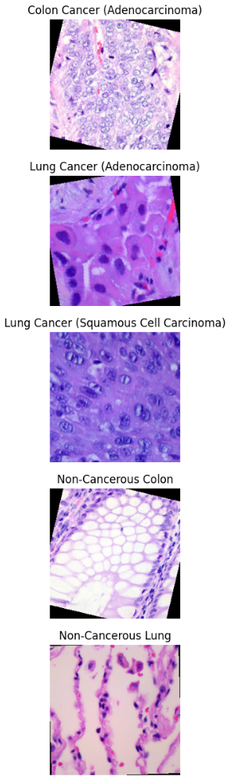
Dataset Information
Name: Lung and Colon Cancer Histopathological Images
URL: https://www.kaggle.com/datasets/andrewmvd/lung-and-colon-cancer-histopathological-images?resource=download
Content: 25,000 histopathological images with 5 classes (Lung benign tissue, Lung Adenocarcinoma, Lung squamous cell carcinoma, Colon adenocarcinoma, Colon benign tissue). All images are 768x768 pixel sized jpeg files. Images were generated from an original sample of HIPAA compliant and validated sources, consisting of 750 total images of lung tissue and 500 total images of colon tissue, augmented to 25,000 using the Augmentor package
Notes:
Our project utilized the Lung and Colon Cancer Histopathological Images dataset, which is an invaluable resource for cancer detection research.
This dataset, available on Kaggle, contains a total of 25,000 high-resolution histopathological images, each measuring 768 by 768 pixels. These images were generated from an original sample of 750 lung tissue images and 500 colon tissue images, carefully augmented using the Augmentor package.
Importantly, the dataset is HIPAA compliant and validated by experts, ensuring its reliability and suitability for medical research.

Slide 5
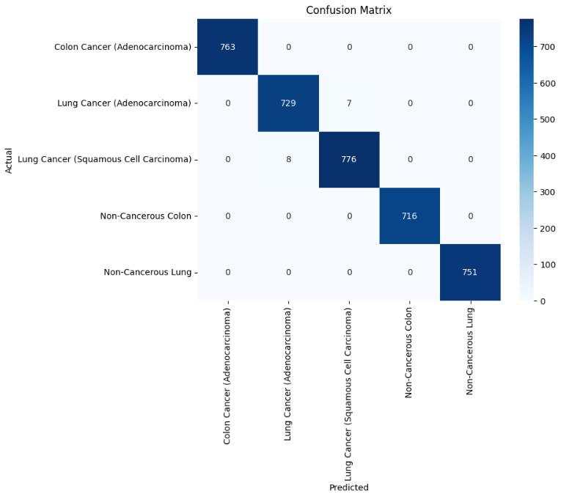
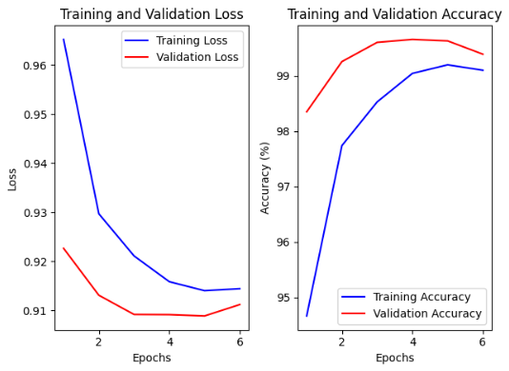
Model Training (MobileNetV2)
Leveraged MobileNetV2 network as the backbone due to efficiency and strong performance on resource-constrained systems
Adapted model for classification of tissue by replacing original classification head with a custom classifier
Implemented early stopping to reduce overfitting and checkpoints to facilitate resuming training and avoiding data loss
Reached a validation accuracy of 99.65% during training
Precision, recall, and f1-score were all basically 1.00 during model evaluation except for a few predictions where the model confused the two types of lung cancer

Slide 6
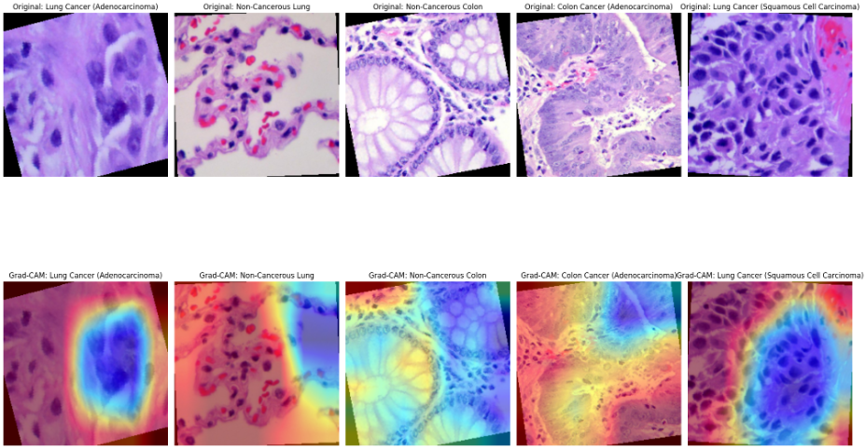
Model Visualization (MobileNetV2)
Grad-CAM heatmap highlights areas of the image most relevant to the model’s decision on what category it belongs to
Hot colors (red, orange, yellow) indicate high focus
Cool colors (blue or absent heatmap) indicate areas with little to no focus
Helps to validate whether the model is attending to meaningful features (tumor regions in this case)
Offers human-readable insights into the model’s reasoning, which is critical in high-stakes applications like medical diagnosis

Slide 7
Improvements
Using outside data to test the model, rather than just the generated images from the dataset, to ensure that the model can recognize cancerous/benign tissue outside of the dataset
Increase the types of cancerous tissue that the model can identify, including tissue from other areas besides lung/colon
Deployment of the model for ease of use

Slide 8
Alternative approach: Data Preprocessing & Exploration
EDA:
Classes: lung_n, lung_scc, lung_aca, colon_n, colon_aca
Dataset had 25,000 evenly divided between the classes for 5,000 each
Removed about 3,000 duplicates to avoid leakage
Preprocessing Steps:
Label encoding
Data augmentation techniques (rotation, zoom, brightness adjustment).
Preprocessing: VGG16: preprocess_inpu, CNN: Rescaled by 1./255
Stratified splitting into training (60%), validation (20%), and test (20%) sets.
Generators: Created generators for each set

Slide 9
Model Architecture
Custom CNN
Multiple Conv2D layers (ReLU activation)
Batch Normalization, MaxPooling, Dropout layers
Fully connected Dense layers
Output: Softmax activation for multi-class classification
VGG16 Transfer Learning
Base Model: Pre-trained VGG16 (ImageNet weights, frozen initially)
Top Layers: Global Average Pooling, Dense (ReLU), Batch Norm, Dropout, Softmax
ResNet50 Transfer Learning
Base Model: Pre-trained ResNet50 (ImageNet weights, frozen initially)
Top Layers: Similar setup as VGG16

Slide 10
Training Strategy
Compilation
Optimizer: Adam (1e-4 initial, 1e-5 for fine-tuning)
Loss Function: Categorical Crossentropy
Metrics: Accuracy, AUC, Precision, Recall
Callbacks
Early Stopping (patience: 5 epochs)
Model Checkpointing (best validation loss)
ReduceLROnPlateau (learning rate reduction)
TensorBoard (metric logging)
Training Phases
Initial Training: Base models frozen
Fine-Tuning: Unfreeze top layers, retrain with lower learning rate

Slide 11
Model Performance Results
Metric | CNN | VGG16 (Fine-Tuned) | ResNet50
Test Accuracy | 95.34% | 91.57% | 73.92%
Test AUC | 0.9971 | 0.9915 | 0.9492
Test Loss | 0.1215 | 0.2295 | 0.6034
Precision | 0.9542 | 0.9233 | 0.7713
Recall | 0.9530 | 0.9054 | 0.6954
F1 Score | 0.9534 | 0.9054 | 0.7259
Matthews Correlation Coefficient (MCC) | 0.9419 | 0.9054 | 0.6840
Log Loss | 0.1238 | 0.2295 | 0.6160

Slide 12
Model Performance Results
CNN:
Accuracy: 95.34%
AUC: 0.99
F1 Score: 0.95
MCC: 0.94
Log Loss: 0.12
VGG16 Fine-Tuned:
Accuracy: 91.57%
AUC: 0.99
F1 Score: 0.90
MCC: 0.90
Log Loss: 0.22
ResNet50:
Accuracy: 73.92%
AUC: 0.94
F1 Score: 0.72
MCC: 0.68
Log Loss: 0.61

Slide 13
Key insights
CNN Dominates Performance:
Highest accuracy (95.34%) and AUC (0.9971)
Balanced precision and recall (0.9542 & 0.9530)
Strong additional metrics (F1: 0.9534, MCC: 0.9419)
VGG16 Shows Strong Performance:
Competitive accuracy (91.57%) and AUC (0.9915)
High precision and recall (0.9233 & 0.9054)
Robust F1 and MCC scores (0.9054, 0.9054)
Potential for Improvement: Further fine-tuning can enhance performance
ResNet50 Underperforms:
Lower accuracy (73.92%) and AUC (0.9492)
Weaker precision and recall (0.7713 & 0.6954)
Lower F1 and MCC (0.7259, 0.6840)
Possible Issues: Model complexity or suitability for dataset

Slide 14
Recommendations:
Test models on additional datasets from other sources:
To avoid any possibility of results being due to data leakage or easy dataset
More Pre-trained Models (InceptionV3, EfficientNet, etc.) and ensemble
Optimize Hyperparameter Tuning: learning rates, batch sizes, and optimizer settings
Data Augmentation: more sophisticated augmentation techniques to improve generalization
K-fold Cross-Validation: more robust validation (resource heavy)
Grad-CAM: Understand the models "thinking", I.E. what factors impact most.
VGG16: Determine into why it performed better in previous iterations (overfitting?)
ResNet50:
Consider alternative architectures or different training configurations
Investigate specific class performance issues

Slide 15
Member Contributions
Seanmark Paz | Jabali Shah | Yaakov Sternberg
Model Training/Visualization (MobileNetV2) Slideshow/Presentation Report (Model Training/Visualization) | Finalized Report Slideshow/Presentation Contributed to code | Wrote way too much code (experimenting with various models & metrics) Slideshow/Presentation Contributed to Report

Slide 16
Thank you!

